Slide 1




Computershare G3 Demo Screens
SHARES Email Registration

Slide 2
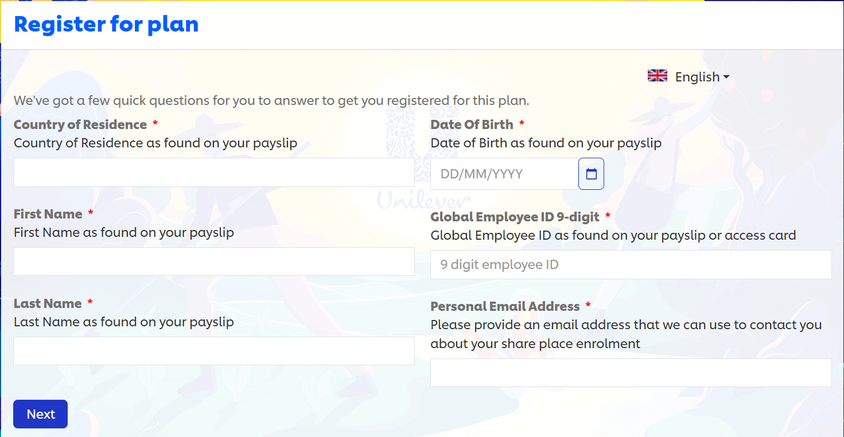
Computershare G3 Demo Screens
Visit G3 website you will be presented with below form

Slide 3
Computershare G3 Demo Screens
The following page will be supported in the additional languages:
English, Spanish, German, French, Portuguese, Italian, Traditional Chinese, Simplified Chinese Japanese, Polish and Dutch.

Slide 4
Computershare G3 Demo Screens
Please type in your Country of Residence

Slide 5
Computershare G3 Demo Screens
Please type in your First Name

Slide 6
Computershare G3 Demo Screens
Please type in your Last Name

Slide 7
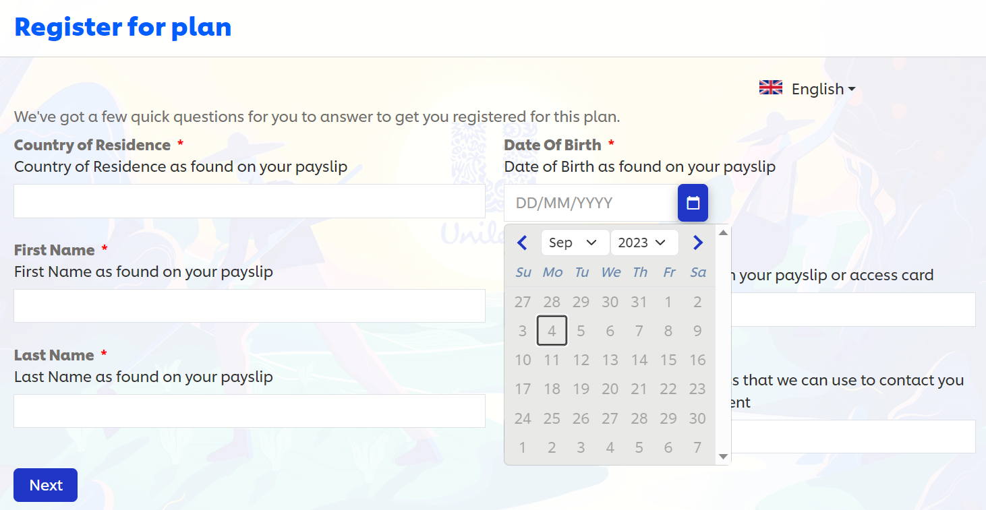
Computershare G3 Demo Screens
Click on the calendar widget and select your Date of Birth

Slide 8
Computershare G3 Demo Screens
Please type in your 9-digit Global Employee ID

Slide 9
Computershare G3 Demo Screens
Please type in your Personal Email address

Slide 10
Computershare G3 Demo Screens
Once completed, please Click Next

Slide 11
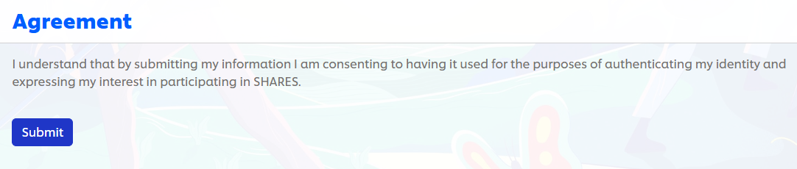
Computershare G3 Demo Screens
Click on Submit

Slide 12
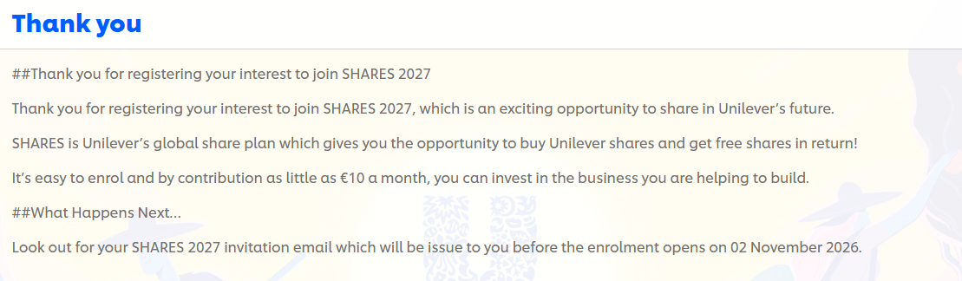
Computershare G3 Demo Screens
Finally, a confirmation screen of your submitted SHARES registration. More information will be sent to your personal email address regarding the next steps.
If you have any additional questions, please contact Computershare using the contact information provided onscreen.
For additional support on the next steps, please refer to our Computershare Activation Guide, available on our ‘Information Hub’ - ShareinourFuture.com.

